Slide 1
FACE MASK DETECTION USING CNN
Presented by:
Kalanidhi S
III year,KVCET
NM ID-au421221243016
Email ID- saravanankalanidhi@gmail.com

Slide 2
PROBLEM STATEMENT
With the ongoing emphasis on public health measures such as wearing face masks, there is a critical need for efficient and accurate methods to enforce compliance in public spaces.
Manual enforcement of face mask mandates is resource-intensive and prone to error, highlighting the necessity for automated systems capable of reliably detecting the presence and proper usage of face masks.

Slide 3
PROPOSED SOLUTION
Implementing a Convolutional Neural Network (CNN) based face mask detection system offers a robust and efficient solution to automatically identify individuals wearing or not wearing face masks in various settings.
By leveraging CNN technology, organizations and authorities can deploy cost-effective and reliable tools to monitor compliance with face mask mandates, thereby enhancing public safety and reducing the burden on manual enforcement efforts.

Slide 4
PROPOSED SYSTEM
.
The proposed system utilizes a Convolutional Neural Network (CNN) architecture trained on a dataset of labeled images to accurately detect the presence and correct usage of face masks in real-time.
Integrated with cameras or surveillance systems, the system processes live video feeds, identifies faces within the frames, and analyzes them to determine whether individuals are wearing masks appropriately, providing instant feedback or alerts as needed.

Slide 5
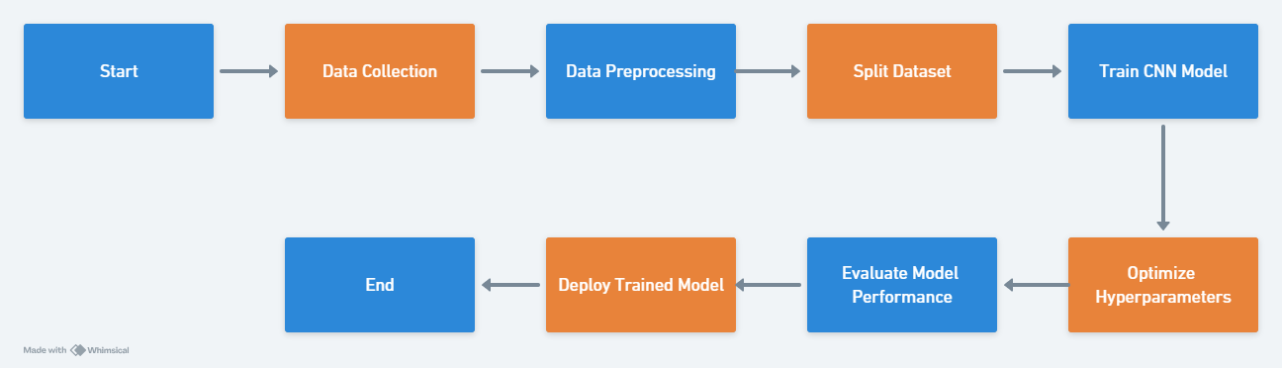

Slide 6
SYSTEM APPROACH
System requirements:
Hardware:
High-performance computing hardware
Cameras or image input devices
Software:
Python programming language
Deep learning frameworks
OpenCV image processing library
Jupyter Notebook

Slide 7
ALGORITHM AND DEPLOYMENT
1. Algorithm Selection: Utilize a Convolutional Neural Network (CNN) due to its effectiveness in image classification tasks like face mask detection.
2. Data Exploration: Explore and preprocess the dataset to understand its characteristics, including the distribution of images with and without masks, variations in lighting, angles, and facial expressions.
3. Deployment: Deploy the trained CNN model using a web application framework like Flask, allowing users to upload images or stream video for real-time face mask detection.

Slide 8
TRAINING AND PROCESS
1. Data Splitting: Divide the dataset into training, validation, and testing sets to ensure the model’s ability to generalize to unseen data.
2. Feature Scaling: Normalize or standardize the pixel values of images to a similar scale to improve the convergence and performance of the CNN model during training.
3. Model Training: Train the CNN model using the training data, adjusting model parameters through backpropagation to minimize the loss function and improve accuracy.
4. Model Evaluation: Assess the performance of the trained model using the validation set, monitoring metrics such as accuracy, precision, recall, and F1-score to gauge its effectiveness in face mask detection.

Slide 9
PREDICTION PROCESS
1. New Data Input: Receive new images or video frames containing faces from the input source, such as a camera feed or uploaded images.
2. Preprocessing: Preprocess the input data by resizing images to the required dimensions, converting them to the appropriate format, and applying any necessary transformations like normalization or standardization.
3. Model Inference: Pass the preprocessed data through the trained CNN model to perform inference, where the model makes predictions on whether each detected face is wearing a mask correctly or not.
4. Result Interpretation: Interpret the model’s predictions, typically by overlaying bounding boxes or labels on the input images to indicate the presence and status of face masks. This information can be used for real-time monitoring, alerts, or further actions as needed.:

Slide 10
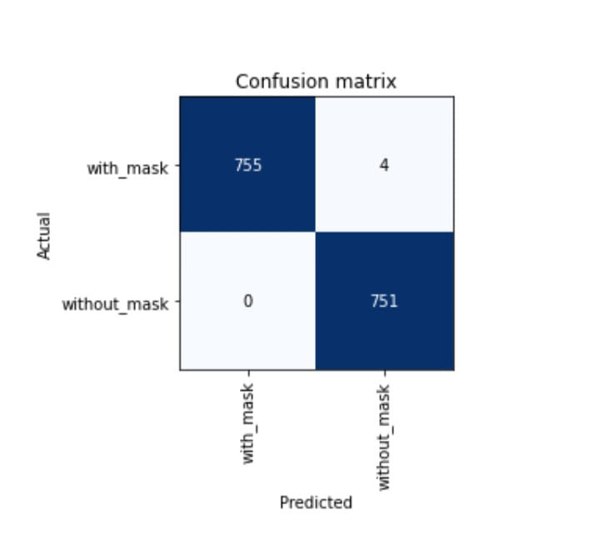
RESULT
1. Achieved high accuracy in face mask detection, with the trained CNN model accurately identifying whether individuals are wearing masks in various conditions and angles.
2. Demonstrated the effectiveness of automated face mask detection systems in enhancing public safety and compliance with health regulations in public spaces.

Slide 11
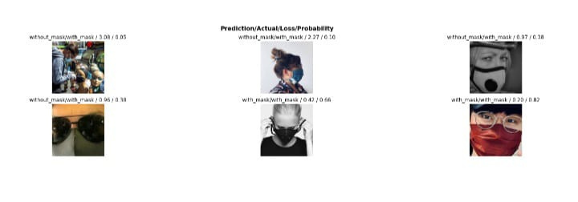
Proposed system :

Slide 12
CONCLUSION
The successful implementation of a Convolutional Neural Network (CNN) for face mask detection represents a significant step forward in leveraging technology to address public health challenges. By automating the process of monitoring mask usage in real-time, the project not only improves efficiency but also contributes to overall public safety efforts. Moving forward, continued research and development in this area hold promise for further advancements in automated surveillance systems and their applications in promoting public health and well-being.

Slide 13
FUTURE SCOPE
1. Mobile Application Integration: Develop mobile applications that leverage the trained model for on-the-go face mask detection, enabling users to assess compliance in real-time.
2. Edge Computing Implementation: Explore the implementation of edge computing techniques to deploy lightweight models on edge devices, facilitating efficient and decentralized face mask detection in various settings.

Slide 14
REFERENCES
Zhang, Y., & Ding, H. (2020). Real-time mask detection based on deep learning. 2020 IEEE 7th International Conference on Industrial Engineering and Applications (ICIEA).2
Chawla, K., & Agrawal, A. (2020). A review on face mask detection using deep learning techniques. International Journal of Scientific Research in Computer Science, Engineering and Information Technology, 5(4), 36-40.

